Slide 1

NBAC Annual Meeting 2020 NIEM’s Path to the Future 18 September
Stuart Whitehead

Slide 2

NIEM, Pathway to the future
NIEM:
Where we’ve been
Where we are
Where we want to be ?

Slide 3
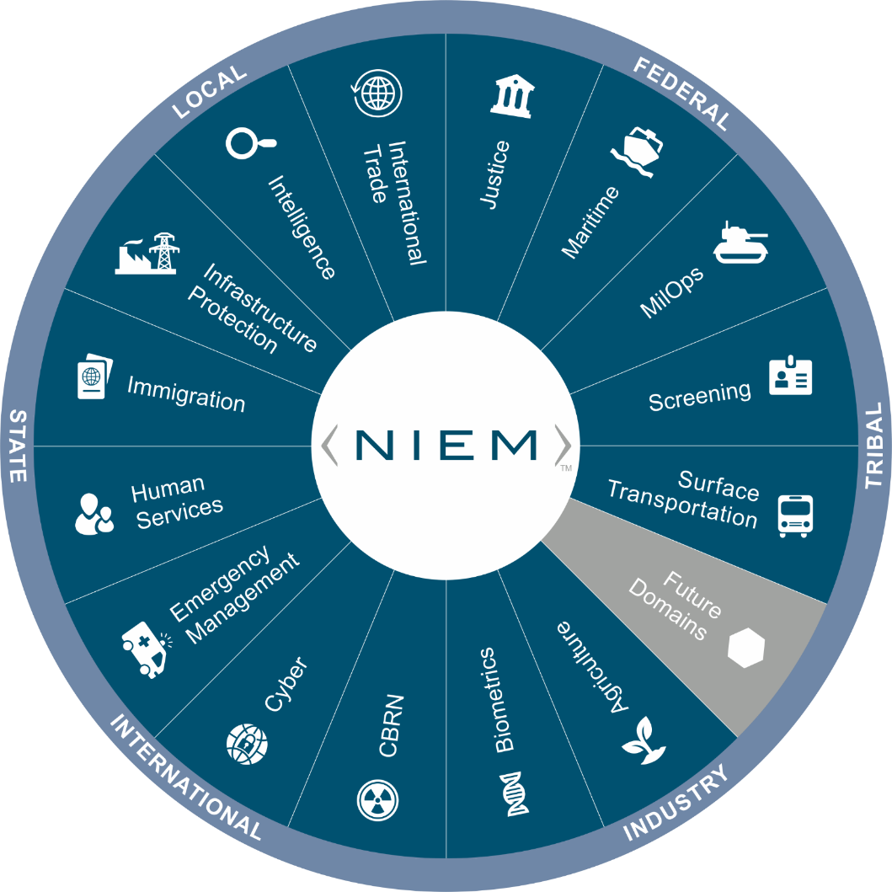
Where we’ve been – Where we are
Classic Data Silo Symptoms
Manual, repetitive data manipulation and reporting tasks
Creating “ad hoc” reports takes hours or days instead of minutes.
There are several versions of the “truth” according to which system you select.
Top barriers to interoperability
Difficulties in accessing relevant data : ICAM
Lack of necessary skills/expertise : Data scientists
Technology/system issues : Legacy IT/hard wired systems
Data quality issues : Unintended/reuse
Organizational silos vs. Enterprise approach
Notes:
Classic Data Silo Symptoms
Symptom 1: Organizations use analysts to support manual, repetitive data manipulation and reporting tasks on a daily, weekly, and monthly basis.
Business Impact – Analysts become bottlenecked doing tasks that can be easily automated. They spend all of their time prepping data and “working on” the data instead of “working with” the data to deliver reports, trends, and insights.
Symptom 2: Creating “ad hoc” reports takes hours or days instead of minutes.
Business Impact – Each time you want to answer a new question or modify your existing reports, someone has to program that new report or change. Real time analysis is impossible.
Symptom 3: There are several versions of the “truth” according to which system you select.
Business Impact – Data access is limited those who know all the nuances and have enough “tribal knowledge” to know what data sources to use and which ones to avoid. This produces further bottlenecks when attempting to deliver reports, trends, and insights.

Slide 4

Data Demands to support the organization
Scenario planning and forecasting
Budget and financial management
Program efficiencies
Financial risk management
Organizational transparency
Reporting
Common Operational Pictures
Decision ready data

Slide 5


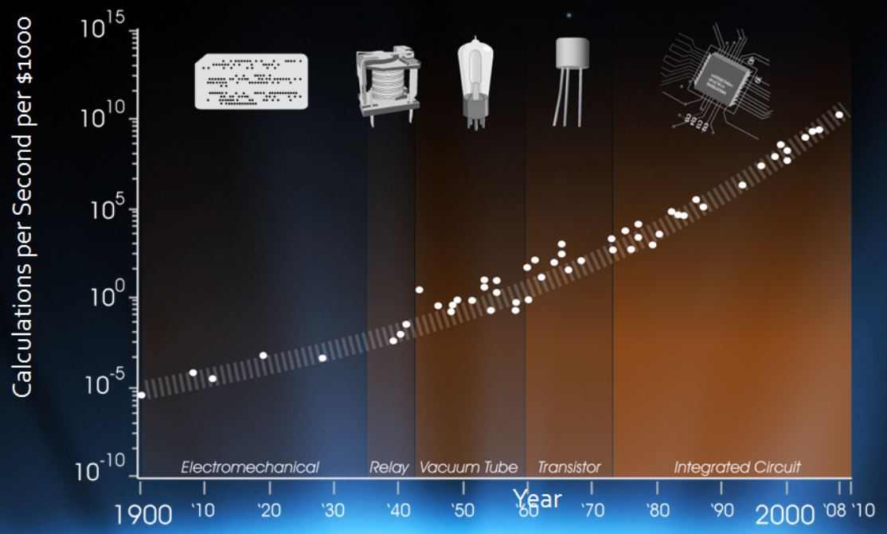

Where we are going
Interoperability as a Nation
Technology is making the world smaller, we need to foster machine to machine interoperability.
Keeping up with the speed of change, Data is at the heart of it all.
Emerging technologies
Artificial Intelligence (AI)
Cloud Computing
Multi-dimensional Data
Competitively Intelligent on a Global scale!
Notes:
Moore's Law states that we can expect the speed and capability of our computers to double every couple of years, and we will pay less for them.
But there is hope. A new generation of tools and technologies is on the horizon. They hold the potential to transform the speed and ease at which companies can extract value from their data and form impactful insights—all while maintaining evolving security and compliance standards.

Slide 6

Where we want to be
Competitive Intelligence on a Global Scale
Enterprise data availability when and how its needed
International leader amongst global competitors
2021 Focus
Meta-model
Internationalization
NIEM as a Standard
Domain Mentorship
NIEM Content Maturation
Increase NIEM Adoption
Position NIEM to meet the requirements of the future
Notes:
Meet the future’s information needs
Scalable Eliminate Data Silos via Automation
Replacing manual, repetitive tasks with automation

Slide 7


